Slide 1

Module 1.8 The impact of ICT

Slide 2
Contents
How ICTs influence our lives and lifestyles
Impact on home office
Impact on education
Computer criminals
Test and improve

Slide 3






How ICTs influence our lives and lifestyles
The way we ...
Do the jobs we do
Store and watch photos & videos
Entertain ourselves (games & music)
Shop and bank
Communicate with others
Interact with friends
Obtain and use information, etc.

Slide 4



How ICTs influence our lives and lifestyles
Communication
social networking
instant messaging
blogging and emailing
Over-availability of communication leads to problems of its own: you can never really ‘switch off’ ☹

Slide 5
How ICTs influence our lives and lifestyles
Access to information
TV/ Radio
Email
!! Information !!
Find it quickly
Determine if source is reliable
Analyse and summarise it accurately


WWW
Cellphone calls
SMS /MMS
✓



Slide 6



How ICTs influence one’s life and life styles
Leisure
Movies, music, printed media via internet
Video on Demand (VOD)
Internet TV – not using radio signals
Online travel bookings
Online computer games
Fitness programs in front of TV with gaming console

Slide 7



Impact on home office
Save money! use the PC to...
type and edit your documents
keep track of your accounts
communicate with clients & suppliers
file and organise client data etc.
advertise your product or service

Slide 8

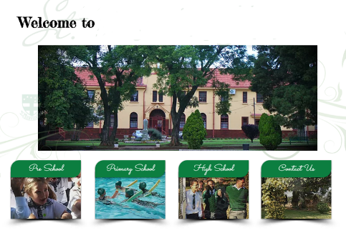


Impact on education
ICT use by school management
Create timetables with special software
Use word processors to produce neat exam papers
Communicate with parents (email / SMS)
Calculate marks in a spreadsheet
Market the school via a website

Slide 9
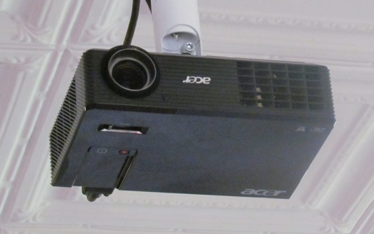
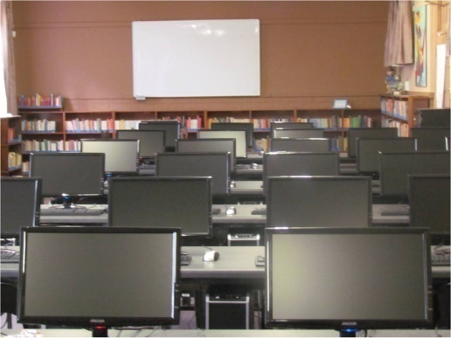
Impact on education
ICT use by teachers
Data projectors
Electronic whiteboards
Lessons and worksheets
Specialised programs for use in geographic information systems (GIS), science experiments, etc.

Slide 10
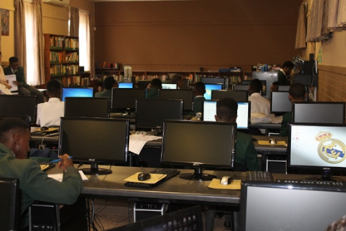
Impact on education
ICT use by learners (1)
Get information from the internet
Process data in Excel
Type up neat assignments in Word
Create diagrams using Paint / SmartArt
Take photos and record interviews with smartphones, etc.

Slide 11
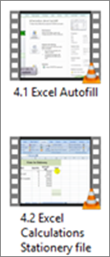
Impact on education
ICT use by learners (2)
Watch videos that explain how to do practical tasks in CAT
Use social networking sites to share with others on various projects
Use a typing tutor or a mathematics drill-and-practice program

Slide 12
Computer criminals
Identity thieves
Why do they try to steal an identity?
to gain access to secret documents / valuable information / your money
to obtain credit or loans, or buy goods
to spread false information
to commit a crime

Slide 13
Computer criminals
Scammers / Phishers
How do they try to steal your money?
Phishing – to get your banking details
Fake websites – to commit fraud
Fake virus alarms – for you to buy ‘protection’ software
Bogus ‘lottery winnings’ or investment opportunities, pyramid schemes, etc.
!

Slide 14
Computer criminals
Employees
How do ordinary employees fit in?
Employees have easiest access to computers
Computer equipment, software, sensitive information, computer time etc. can be stolen
‘Revenge’ actions against perceived injustices by company – can cause serious damage to computers or network

Slide 15
Computer criminals
Hackers and Crackers
Computer criminals who break into computer systems
HACKERS | CRACKERS
Mainly for the prestige or recognition – ‘white hat’ | Intention of performing some crime – ‘black hat’
?? Did you know ??
Companies that specialize in computer security sometimes hire HACKERS to work for them

Slide 16
Computer criminals
Organised computer crime
Exactly what are these syndicates involved in?
Running spam businesses
Stealing secrets (for blackmail etc.)
Copying and selling CDs and DVDs illegally
Using computers to forge documents – passports, credit cards, etc.

Slide 17
Test and improve
Impact on our lives and lifestyles
Communication
Computer criminals
Identity thieves
Over-availability
Leisure
Impact on home office
Scammers / Phishers
Employees
Hackers and crackers
Organised crime
Impact on education
Management
Teachers
Learners
Create own documents
Liaising – clients & suppliers
Information age
Managing data
Advertising

Slide 18
Written module activity

